Slide 1
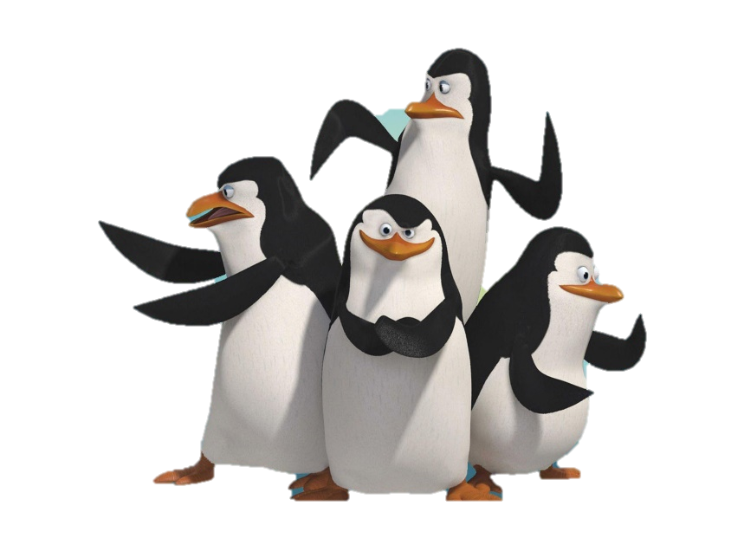
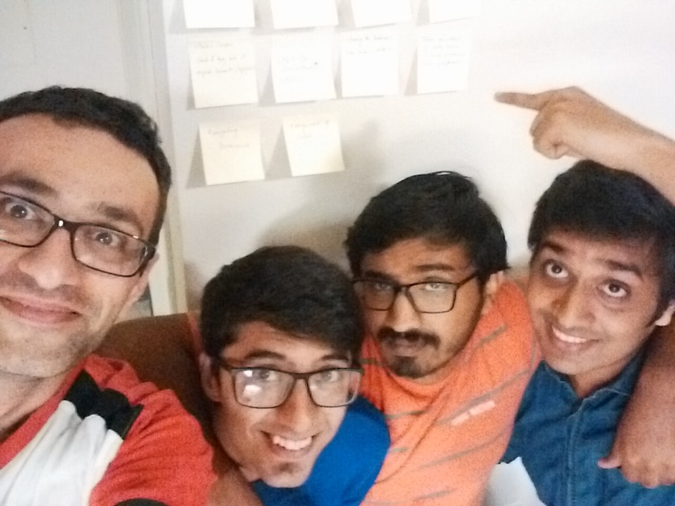
Software Development Class - IST 303 Professor Terry Ryan Gila Breath Camp 2nd Milestone
Team #Penguins:
Jemin Gohil (aka Rico)
Karthik Manjunath (aka Kowalski)
Rohan Sawant (aka Skipper)
Soheil Bouzari (aka Private)

Slide 2
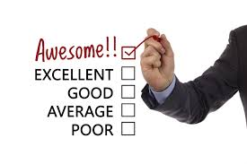

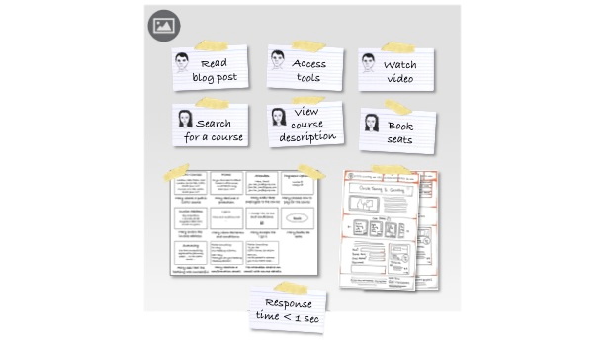
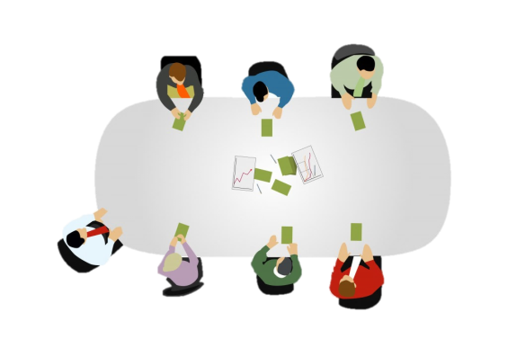

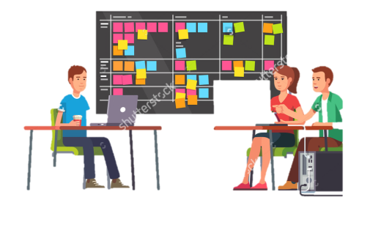
Agenda
Reviews & Take-away
from Milestone 1.0
Gathering Requirements
User Stories
Planning Poker
Estimation of project
Big Board (Initial)
Changes during Iteration
Final Big Board
Milestone 2.0

Slide 3





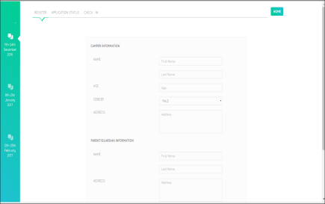
Agenda
Refactoring
SRP
DRY
Version Control
Testing
Code
Demo
Challenges & Learnings

Slide 4
1
Reviews and Takeaway from Milestone 1
• I agree with your classmates that most of what you did was quite good. In particular, you did a strong job of using tools for development and testing.
• I liked your analysis/discussion of commit history.
• I liked your analysis/discussion of refactoring.
• Excellent analysis/discussion of testing.
• The biggest weakness was probably your explanation of requirements gathering. I know that you did this well, but you didn’t explain it well.
• Next biggest weakness was the “domination” of the presentation by Rohan. I attribute this to enthusiasm, but to the class it seemed to be indicative that the other members of the group weren’t as responsible for the accomplishments. I know this is not so, but do a better job with sharing next time.

Slide 5
Summary from Milestone 1
• TEST DRIVEN DEVELOPMENT
1. Unit testing (Wrote small test. But didn’t automate much) – (python packages – unittest)
2. Functional testing (Shown for Registration. Automated fully) – (python packages – pytest)
• Deviated a lot from planned track but due to support from Customer made it up at the end
• Used HTML and javascript as front end and flat files with python Django framework
• 4 user stories – Choosing date, Registration, Application status, Check-In
• 3 iterations (Weekly iterations)

Slide 6
2
Gathering Requirement
Brainstorming:
a. Weekly Talks with professor
Had total of 3 + 5 weekly iterations with professor directly
b. Tried to make flow by understanding Project Requirements document
provided by professor

Slide 7
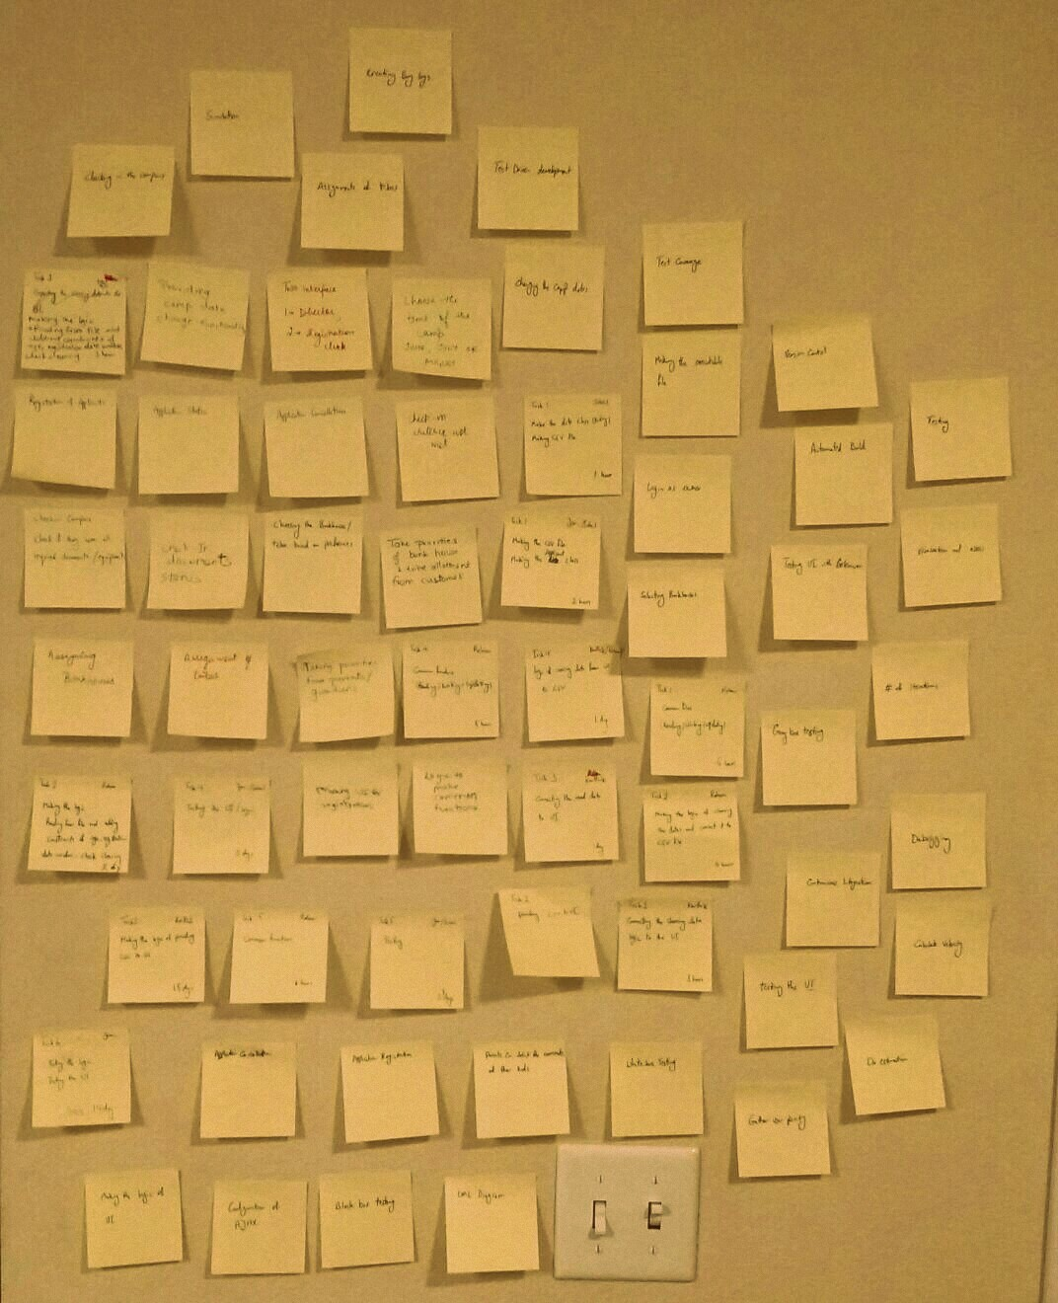
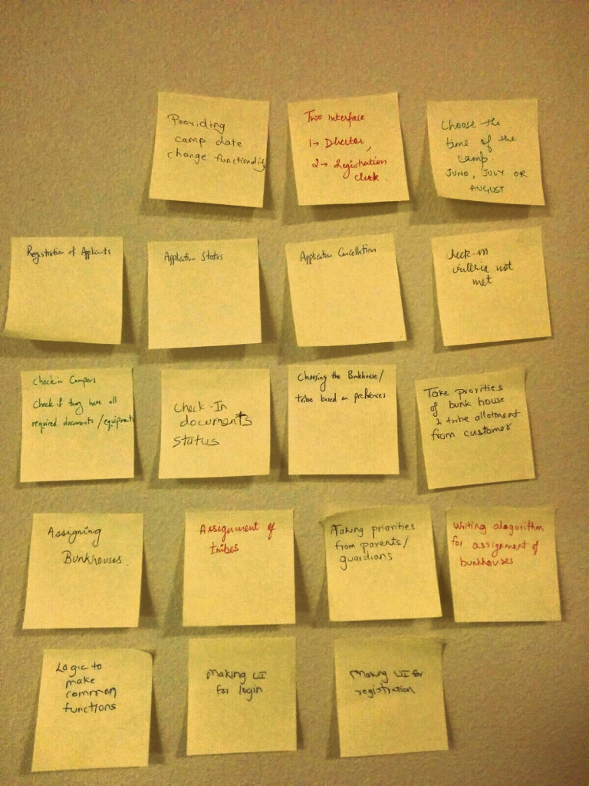
2
Gathering Requirement
2. Blue-skying:
a. Old traditional Way of using sticky notes
b. Did a lot this time to cover all possible scenarios

Slide 8

2
Gathering Requirement
3. Role-Playing:
This was done majorly and was very helpful. Asked lot of colleagues and friends to provide us with suggestions. Some would be referred by Sohiel

Slide 9

2
Gathering Requirement
4. Observation:
a. 1st Milestone – Other task
like printing of notices is something we missed out.
b. http://www.activecamps.com/
Online websites

Slide 10
3
Project Planning (Planning Poker)
Prioritizations | User Stories | Rohan | Jemin | Karthik | Soheil | Average
10 | Priorities from Guardian | 9.00 | 4.00 | 6.00 | 5.00 | 6.00
10 | Assignment of Bunk Houses | 8.00 | 9.00 | 10.00 | 12.00 | 10.00
10 | Assignment of Tribes | 5.00 | 10.00 | 12.00 | 14.00 | 11.00
10 | Printing of acceptance notice | 7.00 | 6.00 | 8.00 | 8.00 | 8.00
20 | Application Cancellation | 5.00 | 3.00 | 9.00 | 8.00 | 7.00
20 | Refund | 7.00 | 9.00 | 8.00 | 9.00 | 9.00
25 | Printing of non-fulfillment of request | 4.00 | 4.00 | 5.00 | 7.00 | 5.00
25 | Log In | 3.00 | 3.00 | 5.00 | 5.00 | 4.00
 | Total Sum | 39.00 | 44.00 | 57.00 | 63.00 | 51.00
Prioritization given by customer
Notes:
We did planning poker when each one provided with estimated time in days for each user story. Except for login and prin

Slide 11
4
Project Planning
(Estimation of project schedule)
Milestone 2.0 | Calculation
Start Day | 10/21/2016
End Day | 12/5/2016
Number of days before release (Calendar days) | 46.00
Estimated Days of Work | 60.00
Number of people in Team | 4.00
Number of workdays left (Only Week Days) | 32.00
Holidays by Developers | 0.00
Number of workdays left (Excluding Holidays) | 32.00
Velocity | 0.40
Available Work Days | 12.80
Amount of work team is likely to complete before due date | 51.00
Days of work that could be deferred | 9.00
More working days (1st Milestone – 31)
More work days left (1st Milestone – 22)
Same Velocity
3rd Milestone

Slide 12
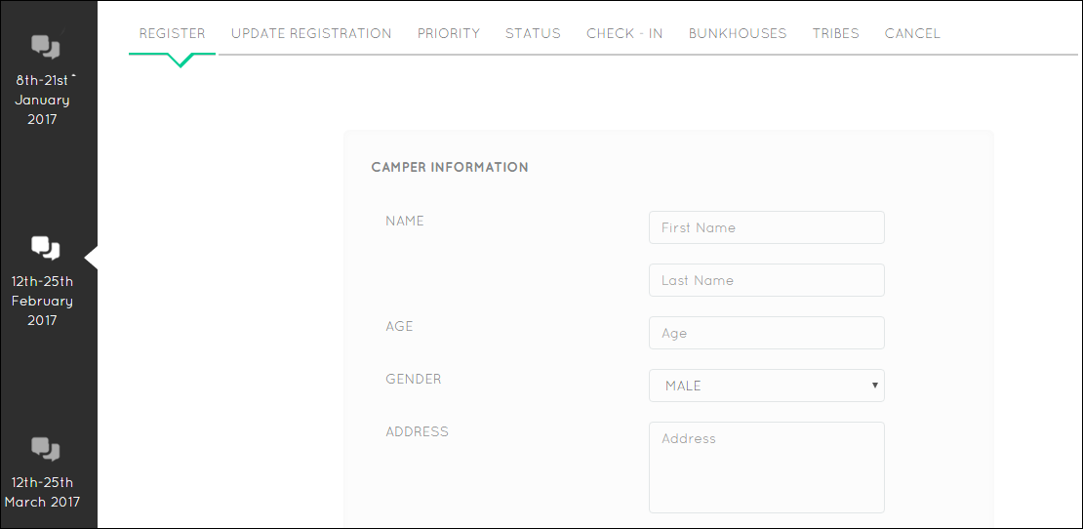
3
User Stories
1st Milestone
Notes:
I will explain you the user stories by going through the application itself .
Here we can see the choice of date could be done which was part of our User story.
Every applicant needs to register and hence we have the register User story along with a update registration user story
These were a part of 1st milestone

Slide 13
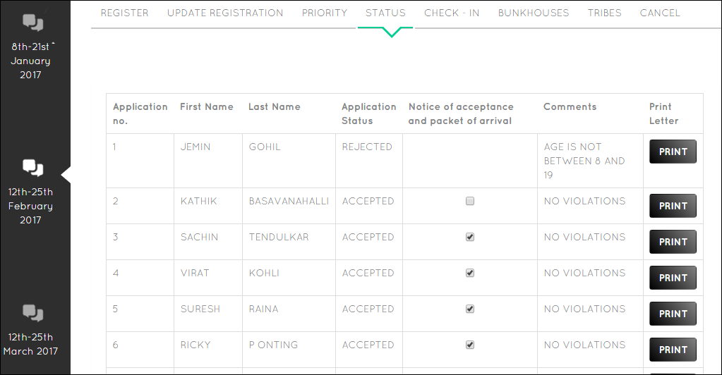
3
User Stories
2nd Milestone
Printing
(New User Story derived by observing other groups)
1st Milestone
Notes:
After registration we show the status of the of the applicant whether it is accepted or rejected along with comments if rejected.
This was part of 1st milestone.
Here we have added a new story called as printing which is a part of 2nd milestone.
This was derived by observing other groups as explained by Rohan here

Slide 14
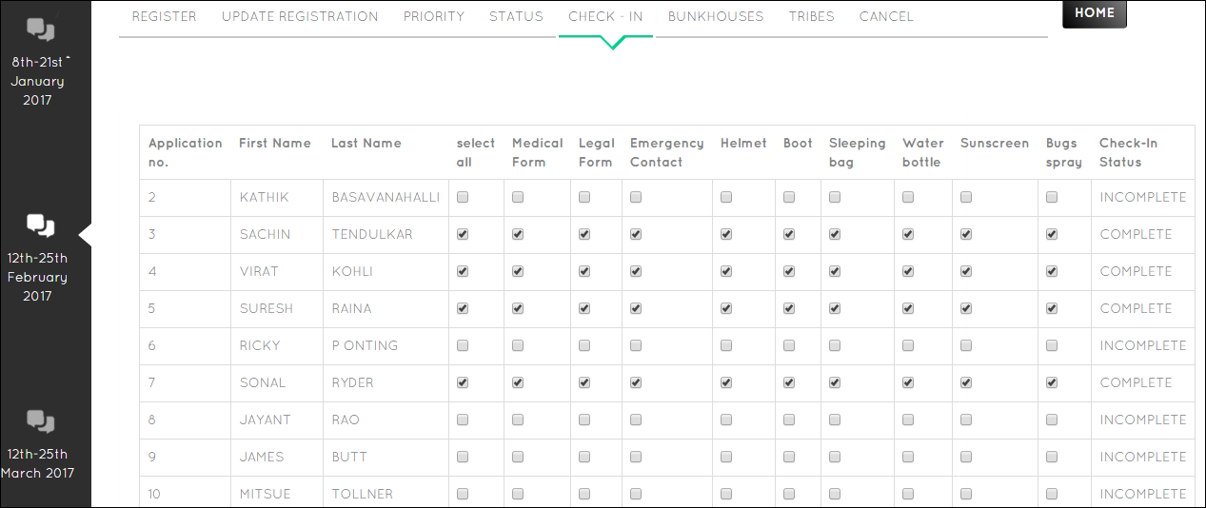
3
User Stories
Improvement made in 2nd Milestone after recommendation after Role-play with colleague
1st Milestone
Notes:
Here we shows the check-in for accepted applicants only which was the part of the 1st Milestone
Here we added Select all to increase user experience which was recommendation given by one of our colleagues after doing role play which again referred by Rohan in gathering requirement

Slide 15
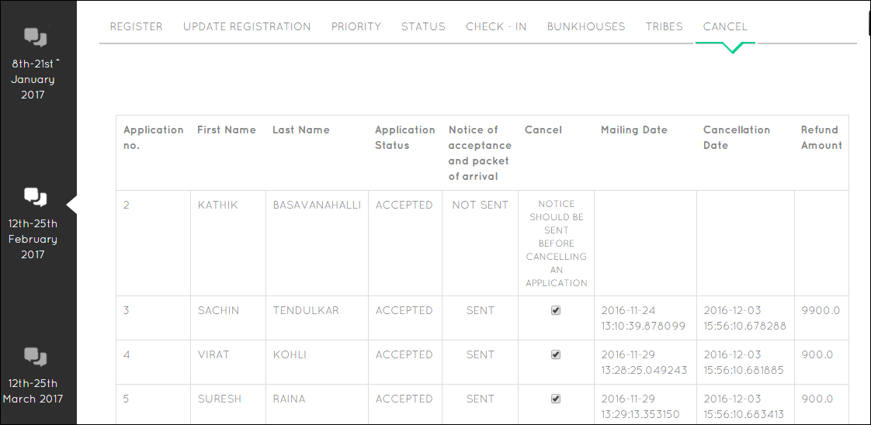
3
User Stories
2nd Milestone
Refund
Notes:
We added a new user story of cancellation only for accepted applicants. Cancellation could be done only if the notice is sent and that’s the option we have provided. Here we have also incorporated the refund amount user story.

Slide 16
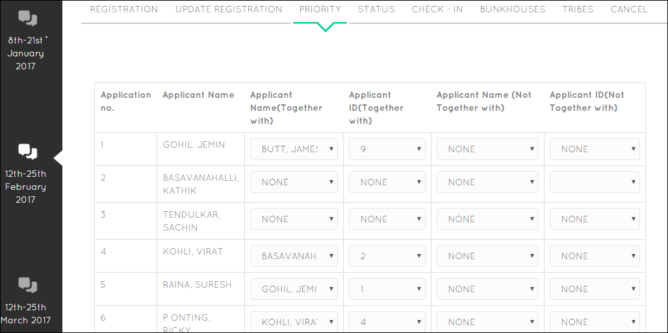
3
User Stories
2nd Milestone
Notes:
This is “taking priority” user story. Here we collect information whether the applicant wants to stay together or not together with another applicant.
This is a part of 2nd milestone

Slide 17
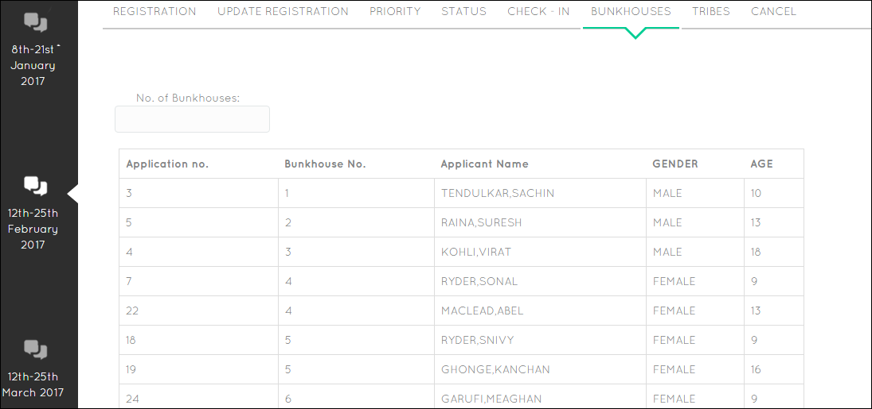
3
User Stories
2nd Milestone
Notes:
Then we come across the user story of assigning applicants to Bunkhouses. Here we could see the number of bunkhouses option which shows that number of bunkhouses could be changed dynamically

Slide 18
3
User Stories
2nd Milestone
Notes:
Then we come across the user story of assigning applicants to Bunkhouses

Slide 19
4
Design
User Story: Priorities from Guardian
Task No | Task | Developer | Time
1 | Making the Priority class entity | Rohan | 2 hours
 | Updating the CSV file
2 | Making the logic for applying priorities | Rohan | 6 hours
 | Connecting it to the CSV File
3 | Connecting the priority logic to the UI | Karthik | 1 day
4 | Testing the logic | Jemin & | 2 days
 | Testing the UI | Soheil
User Story: Assignment to tribes
Task No. | Task | Developer | Time
1 | Making the Tribes class entity | Soheil | 3 hours
 | Updating the CSV file
2 | Making the logic for assigning Tribes | Rohan | 9 hours
 | Connecting it to the CSV File
3 | Connecting the Tribes logic to the UI | Karthik | 2.5 days
4 | Testing the logic | Jemin | 7 days
 | Testing the UI
User Story: Assignment to Bunkhouses
Task No | Task | Developer | Time
1 | Making the Bunkhouses class entity | Soheil | 3 hours
 | Updating the CSV file
2 | Making the logic for assigning bunkhouses | Rohan | 9 hours
 | Connecting it to the CSV File
3 | Connecting the bunkhouse logic to the UI | Karthik | 2.5 days
4 | Testing the logic | Jemin | 5 days
 | Testing the UI
User Story: Printing of Acceptance or Rejection Notices
Task No. | Task | Developer | Time
1 | Making the Printing of notices class entity | Soheil | 4 hours
2 | Making the logic for printing of notices | Jemin | 1 day
 | Connecting it to the CSV File
3 | Connecting the printing logic to the UI | Karthik | 1.5 day
4 | Testing the logic | Rohan | 4 days
 | Testing the UI

Slide 20
4
Design
User Story: Refund
Task No. | Task | Developer | Time
1 | Making the Refund class entity | Rohan | 3 hours
 | Updating the CSV file
2 | Making the logic for refund | Jemin | 1.5 day
 | Connecting it to the CSV File
3 | Connecting the refund logic to the UI | Karthik | 9 hours
4 | Testing the logic | Jemin & | 5 days
 | Testing the UI | Soheil

Slide 21
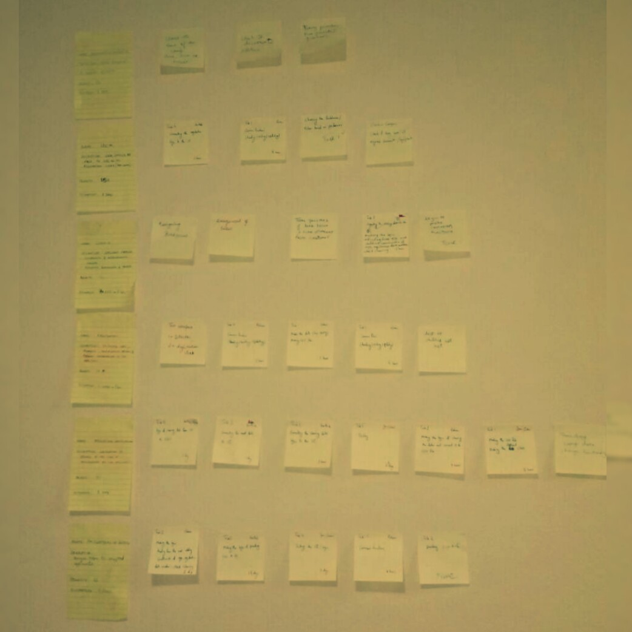
4
Design (Big Board)

Slide 22
4
Design –
Burn Down Chart (Iteration 8)

Slide 23
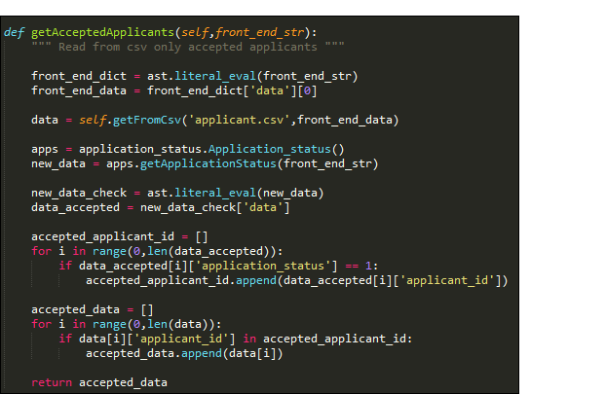
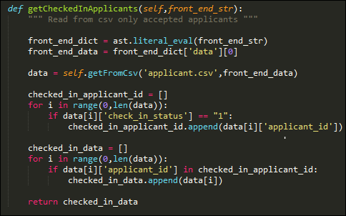
4
Design –
Refactoring: SRP & DRY
Moved to Common Functions class after refactoring

Slide 24
7
Continuous Integration: Version Control
As GitHub is easily accessible to all and we wanted a more secure version control tool for our code, so we shifted from GitHub to BitBucket.
Link: https://bitbucket.org/Rohan9969/software_development_cgu/overview
Git commands:
gitclone https://Rohan9969@bitbucket.org/Rohan9969/software_development_cgu.git
git pull
git add .
git commit –a –s
git push origin master
Merge conflicts:
git checkout <files creating conflict>

Slide 25
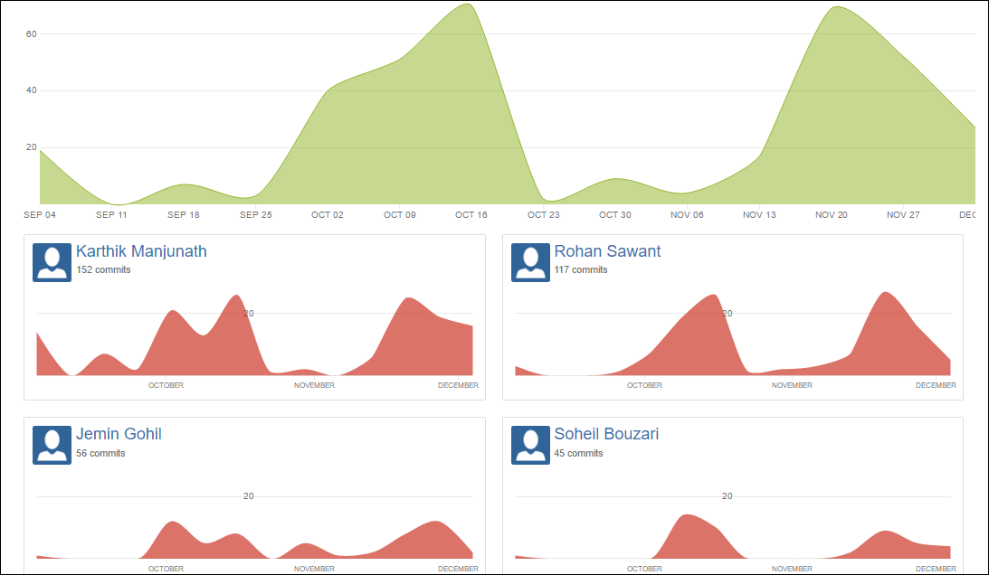
7
Version Control
Most of the work done at the end, but got to a stable point till Dec 4.

Slide 26
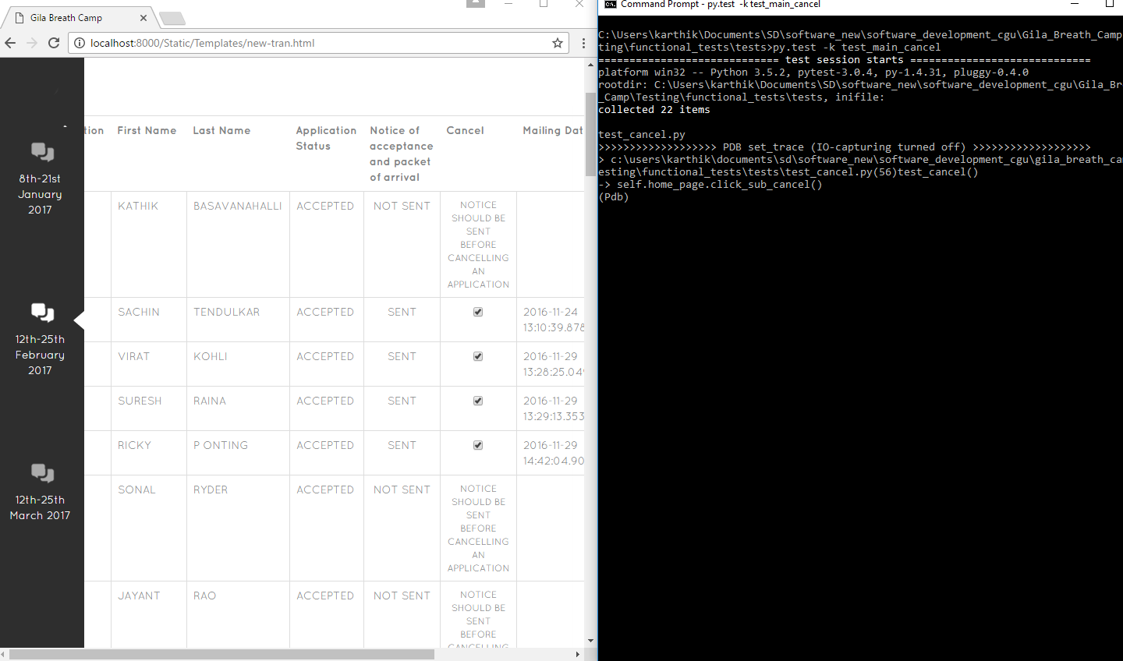
9
Test-Driven Development
Black-box testing

Slide 27
9
Test-Driven Development
Grey-box testing

Slide 28
9
Test-Driven Development
White-box testing
Unit Test
PY Test
Functional Test

Slide 29
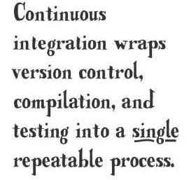
9
Test-Driven Development
Automated Building
Automated testing

Slide 30
9
Bugs

Slide 31
10
Code and UI
Lets got to UI and check it out

Slide 32
11
Challenges
1. Everyone:
a. Estimation of time for user stories
b. Making data for our testing
c. Balancing of workload
2. Rohan/Karthik: Understanding the testing module – unittest
3. Soheil: Balance the workload with other courses – Understanding
Some actual project coding standards
4. Jemin: Understanding the software development practices in actual running application

Slide 33


Slide 34
REFERENCES
http://www.thehealthcarepeople.com/2015/02/16/top-three-challenges-healthcare-professionals-physicians/
https://docs.python.org/2/library/unittest.html
https://www.djangoproject.com/
https://docs.python.org/2/howto/webservers.html
http://stackoverflow.com/questions/5788521/reading-a-csv-file-using-python
https://guides.github.com/activities/hello-world/
http://lifehacker.com/5983680/how-the-heck-do-i-use-github
https://www.python.org/about/success/

